Slide 1
Automated Waste Segregation Using
Convolutional Neural Networks and ResNet on the Garbage Classification v2 Dataset
Team Incognito:-
Hhema Priiya Saidhapeta Naga (hs843)
Roopesh Kumar Reddy Kaipa (rk979)
Shiva Shashank Reddy Chevella (sc2696)
Tanuja Swathi Seeram (ts695)

Slide 2
Abstract
Our aim is to create an AI-based waste classification system using Convolutional Neural Networks (CNNs) models like RESNET-50, MobileNet V3 and EfficientNet-B0 in order to resolve the growing issue of waste generation. The model classifies and predicts waste into categories such as metal, glass, biological, paper, plastic, batteries, trash, cardboard, shoes, and clothing using the Kaggle Garbage Classification v2 dataset. The system suggests the proper bin for disposal and provides real-time predictions. Data preprocessing, model training, and the development of an intuitive deployment interface are all steps in the process, which uses automated segregation to promote sustainable waste management.

Slide 3
Motivation
01
Increasing Waste Generation: Rapid urbanization and population growth are leading to an exponential rise in solid waste production globally.
02
Manual Segregation is Inefficient: Human-led waste segregation is time-consuming, prone to errors, and poses health risks to sanitation workers.
03
Need for Automation: There’s a growing need for fast, accurate, and automated systems to classify waste for efficient recycling and disposal.
04
Support for Sustainable Practices: Proper segregation supports recycling, reduces landfill use, and promotes environmental sustainability.

Slide 4
Objective Of The Project
01
Development of a CNN ResNet Based Waste Classification Model:- Training an Optimizing the hybrid Convolutional Network(CNN) with ResNet architecture using the Garbage Classification dataset which help in enhancement of classification accuracy and feature extraction.
02
Optimizing the Real-Time Waste Detection and Classification:- Ensure that the CNN ResNet model is optimized for the real time waste classification with high accuracy and low latency which makes it practical for the automated waste segregation.
03
Integration of the trained model to a Web Interface:- After completing the backend training then link it to a front end web interface where when the image of the waste is uploaded then the model identifies and we get the real time classification result.
04
Enable Future Multi-category Waste Segregation:- Designing the system to be expandable as in case in future if wanted can add some enhancements like multi-label classification, Iot integrated smart bins and automated robots which can help in segregation.

Slide 5
Literature Review
The study divides household waste into 12 categories using CNNs and a dataset of 15,515 images. DenseNet121, EfficientNetB0, InceptionV3, MobileNetV2, ResNet50, and VGG16 models are compared. The accuracy of the Xception model and Nadam optimizer is 89.57%. Through automated classification, the technology tries to improve trash management.
ResNet-34 was used to develop a deep learning-based waste sorting system that can identify both biodegradable and non-biodegradable waste. The system uses a camera to capture photos and an Arduino to automate sorting from a dataset of 2,566 images. The multi-category model's 93.2% accuracy rate shows how deep learning may be used to reduce human labor and improve the sustainability of waste management.
An efficient waste sorting bin for recyclable municipal solid waste was developed. Convolutional Neural Networks (CNN) are used in it, for classification, The Beginning-ResNet V2 model is used. Object detection can also used for it. The system aims to reduce ecological pollution, improve recycling rates, and increase waste collection efficiency.

Slide 6
Problem statement
One of the major challenges faced globally is effective waste management, recycling, and reducing environmental pollution—all of which heavily rely on proper waste segregation.
Manual waste segregation is often time-consuming, error-prone, and inefficient, making it unsuitable for large-scale adoption.
To address this, our project aims to develop an automated waste segregation system using Convolutional Neural Networks (CNNs) and ResNet to classify waste materials into categories such as metal, glass, biological, trash, battery, cardboard, clothes, shoes, plastic, and paper.
We further enhance this system with a web-based interface that allows users to upload an image of waste, upon which the model predicts its category with high accuracy—enabling faster and smarter waste disposal decisions.

Slide 7
Problem solution
To overcome the inefficiencies of manual waste segregation, we propose an AI-driven automated system that utilizes Convolutional Neural Networks (CNNs) and advanced deep learning architectures like ResNet50, EfficientNetB0, and MobileNetV3 for accurate image-based waste classification.
By training these models on the publicly available Garbage Classification v2 dataset from Kaggle, our system can categorize waste into ten distinct classes, including metal, glass, plastic, paper, and more.
The solution is deployed through a web-based interface that allows users to upload an image of waste material. The trained model then processes the image and instantly predicts the appropriate waste category. This approach not only improves accuracy and speed but also scales effectively to support smart waste management systems, contributing to cleaner environments and more efficient recycling practices.

Slide 8
Methodology & Phases of development
Gathering of the Dataset
Preprocessing Dataset
Dividing the dataset into train-test split
Training ResNet-50 model
Training mobileNet-V3 model
Training EfficientNet-B0 model
Web App Development
Testing & Validation

Slide 9
Dataset Description:-
Dataset Link: Garbage Classification v2
The Garbage Classification v2 dataset isan excellent, meticulously annotated set of photos created to support computer vision and machine learning initiatives related to recycling and garbage management. For academics, developers, and educators interested in creating AI-powered solutions for automated waste segregation, sustainability projects, and environmental education, this dataset is especially helpful.
Overview of dataset : - Total Images:- 19,762
Image Distribution:-
Plastic:-1,984 Images Glass:- 3,061 images biological waste:- 997 images
Metal:- 1,020 Images shoes:- 1,77 images
Clothes:-5,327 Images cardboard:- 1825 images

Slide 10
Key features :-
Application:-
1. Balanced Representation
2. Diverse Categories
3. Real-world Relevance
4. High-Quality images
1. Automated Waste Management
2.Solution for Recycling
3.Environmental Awareness
4.Smart City Sustainability

Slide 11
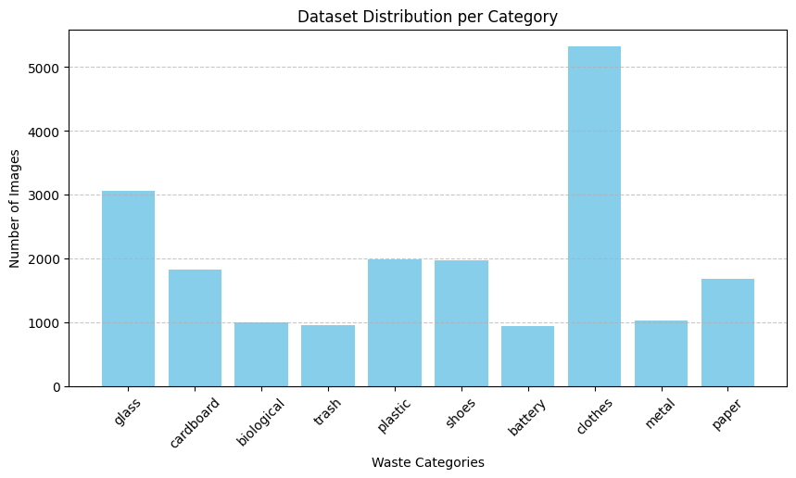
Analysis & Data Representation :-
Figure 1:shows the dataset distribution, with the Clothes category having the most images. To avoid class imbalance issues, we ensure equal image sampling from each category. This helps maintain balanced representation during training.

Slide 12
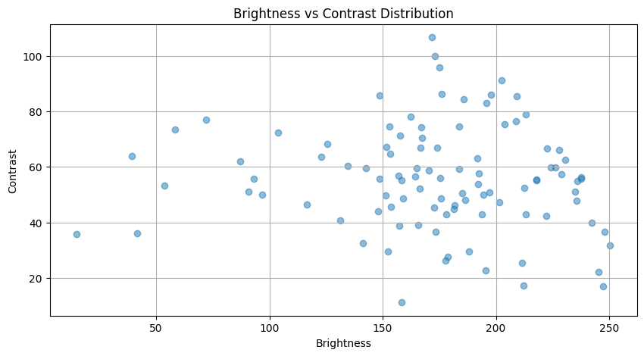
Figure 2: illustrates brightness and contrast distribution in the dataset. Variations like overexposure or sharpness can affect feature extraction. Contrast normalization is applied to standardize images for accurate waste classification.

Slide 13
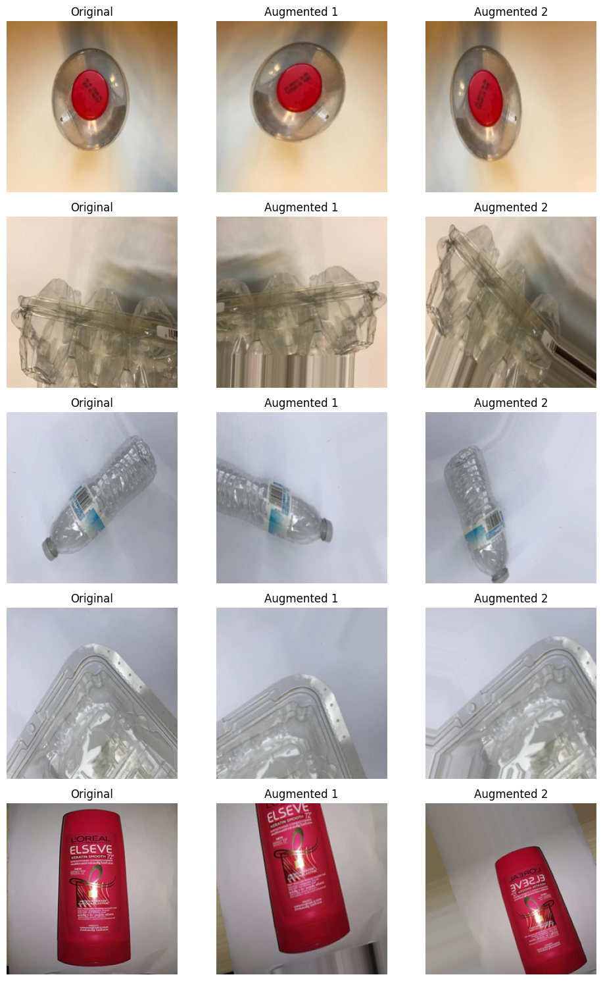
Figure 3: The visualization shows image augmentations like rotation, zoom, and distortions to enhance model learning. Augmenting limited data improves plastic classification accuracy. It also boosts performance on unseen data, aiding efficient waste management.

Slide 14
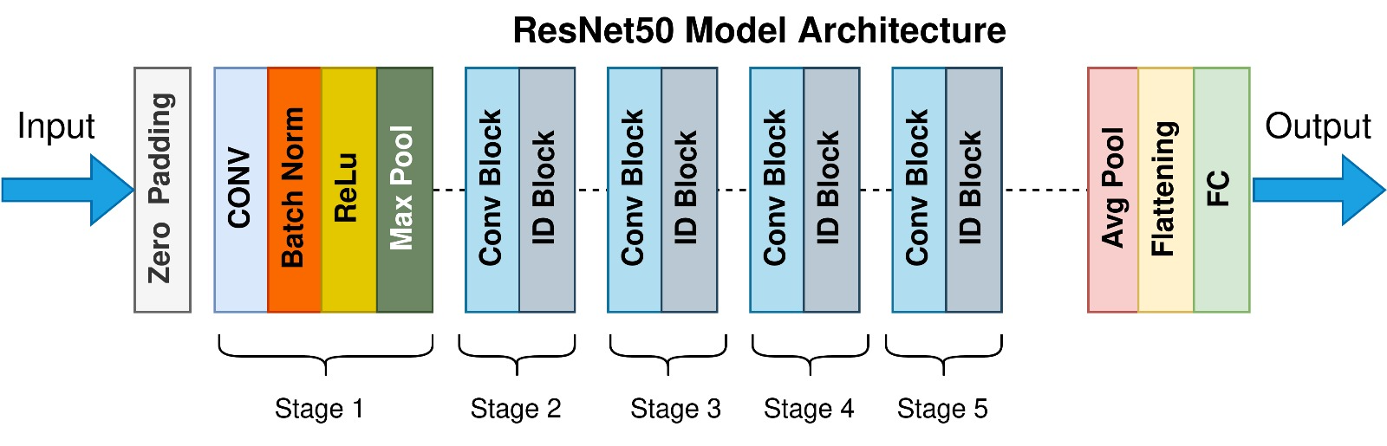
Models Used and Their Architectures
In our project, we explored and compared the performance of three powerful Convolutional Neural Network (CNN) architectures: ResNet50, EfficientNetB0, and MobileNetV3.
ResNet50 uses residual connections to overcome the vanishing gradient problem, allowing for deeper networks with improved accuracy. It consists of 50 layers, including convolutional, identity, and shortcut connections.

Slide 15
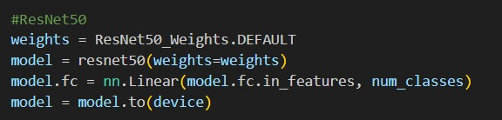
Snippet code for ResNet50 Model

Slide 16
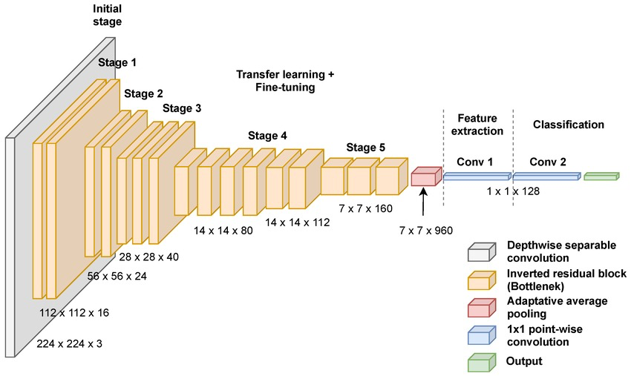
MobileNetV3 is designed for mobile and embedded devices. It uses depthwise separable convolutions and Squeeze-and-Excitation (SE) blocks to reduce computation while maintaining accuracy.

Slide 17
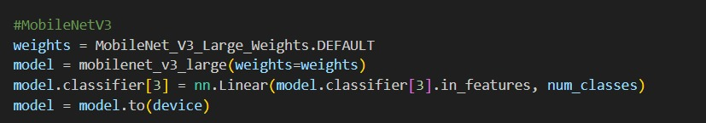
Snippet code for MobileNet V3 Model

Slide 18
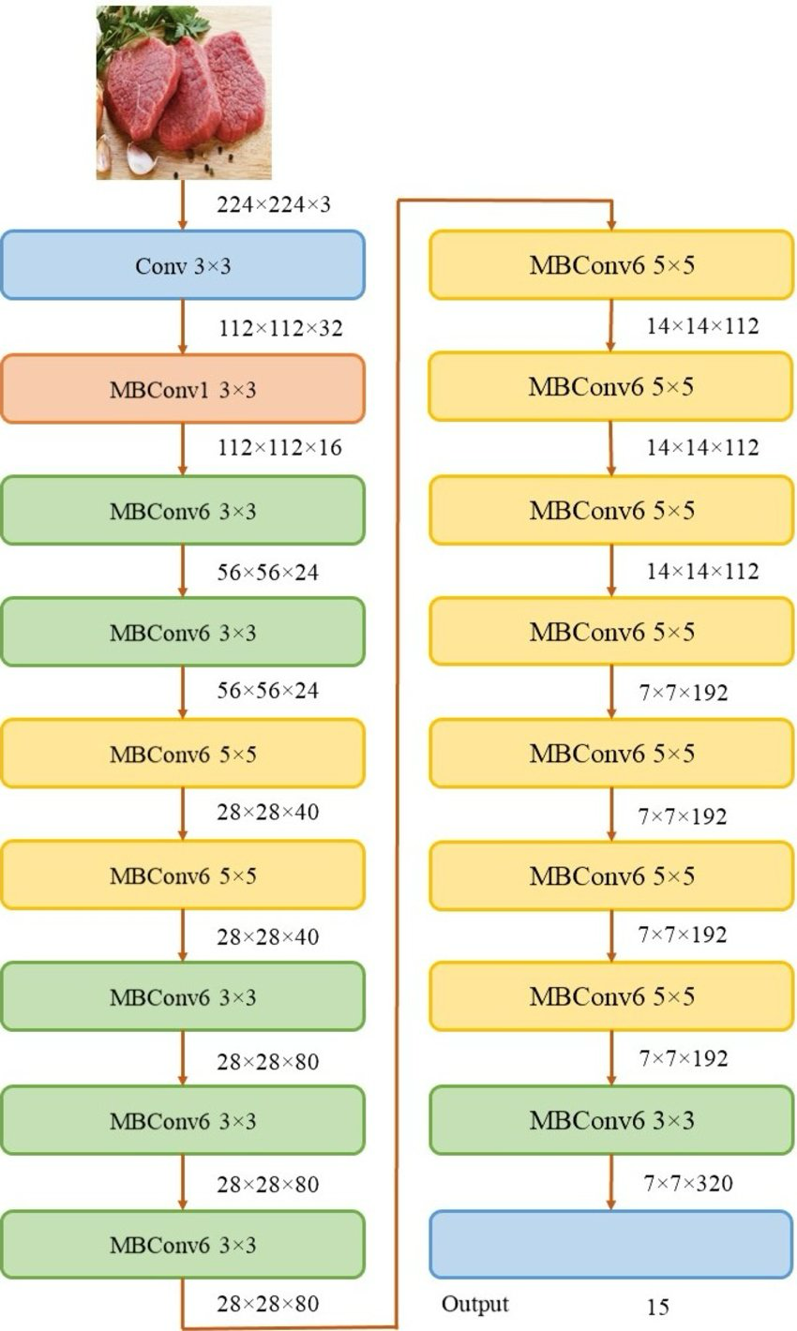
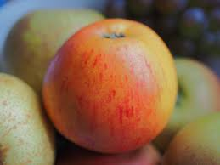
EfficientNetB0 introduces a compound scaling technique that uniformly scales network depth, width, and resolution. Despite being lightweight, it achieves excellent accuracy by optimizing all dimensions efficiently.
These architectures were fine-tuned on the Garbage Classification v2 dataset, and their outputs were evaluated based on accuracy, precision, recall, and F1-score.

Slide 19
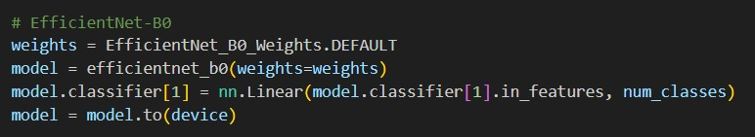
Snippet code for EfficientNet B0 Model

Slide 20
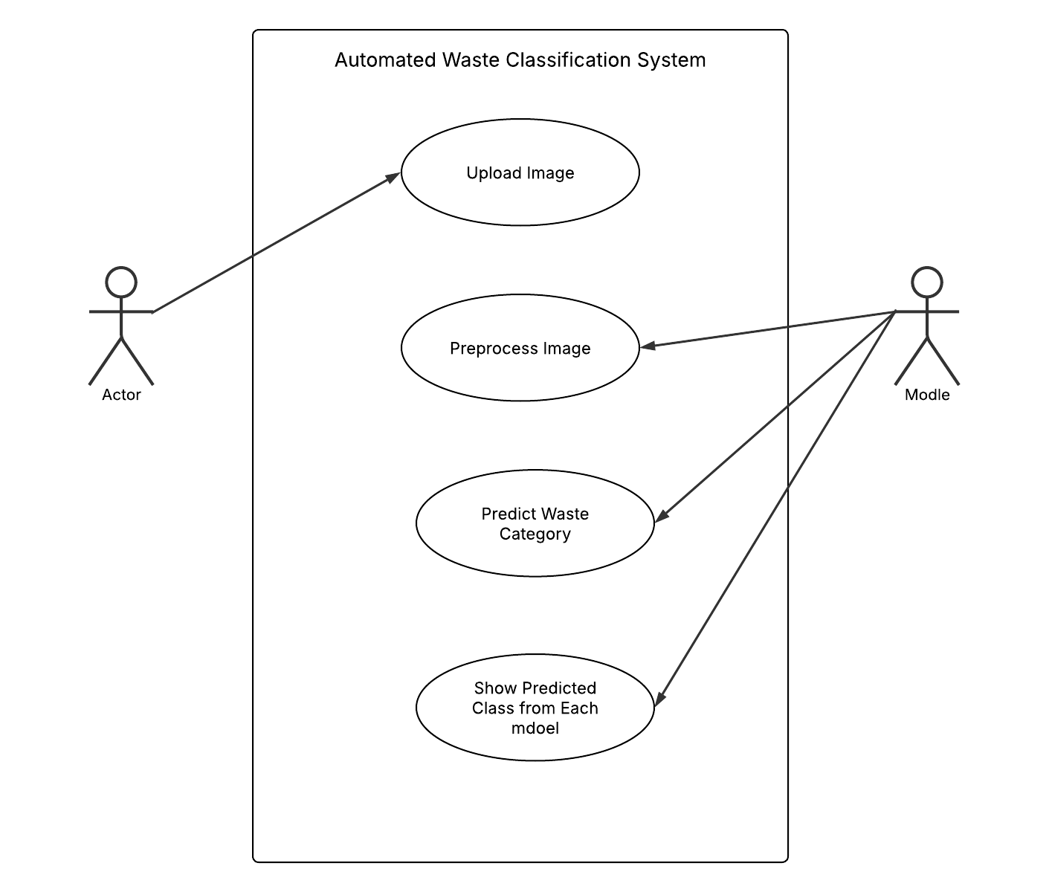
Use Case diagram
Model

Slide 21
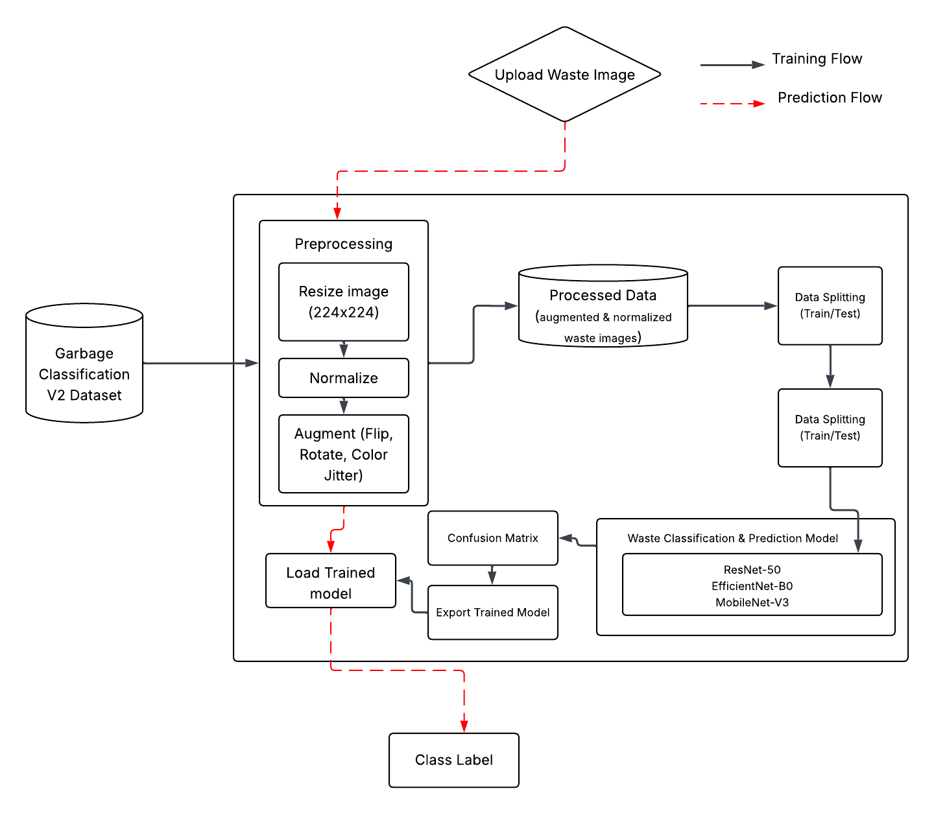
Architecture diagram

Slide 22
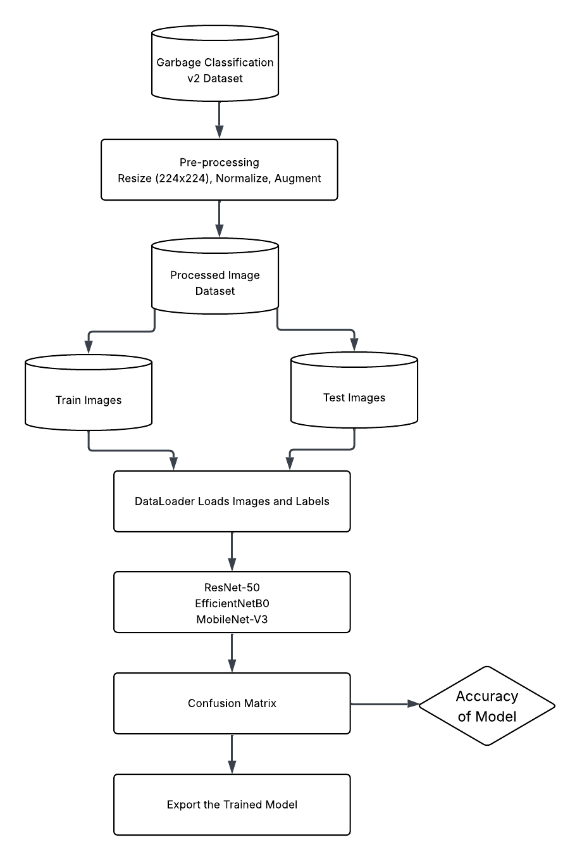
Activity diagram

Slide 23
Advantages
01
AUTOMATION OF WASTE SORTING
Reduces the need for manual labour and minimize human error in waste classification
02
FASTER AND SCALABLE PROCESSING
Can handle large volume of garbage images efficiently , with real-time or near-real-time predictions
03
ADAPTABILITY ACROSS ENVIRONMENT
Can be integrated into smart bins, recycling plants or municipal waste systems.
04
COST EFFICIENT IN THE LONG RUN
Once deployed, reduces operational costs by automating repetitive tasks.
05
PROMOTES ENVIRONMENTAL SUSTAINABILITY
Enables proper recycling, reducing pollution and landfill overflow.

Slide 24
Disadvantages
01
DEPENDENCY ON IMAGE QUALITY
Poor light,blurry pictures or objects can reduce model performance.
02
DATASET LIMITATIONS
If the datasets does not include diverse real-world images, the model might underperform in practical scenarios.
03
HARDWARE REQUIREMENTS
Requires GPU or high performance servers for fast processing and deployment.
04
MODEL BIAS
If not properly regularized, models might overfit on training data and generalize poorly on unseen data.
05
LIMITED TO VISUAL FEATURES
Cannot distinguish between material that look similar (eg:- biodegradable vs non-biodegradable) without additional sensor.

Slide 25
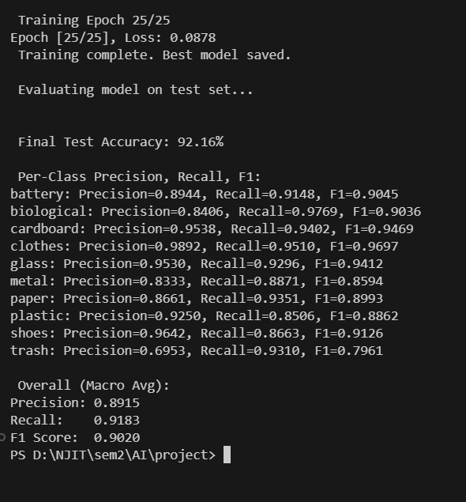
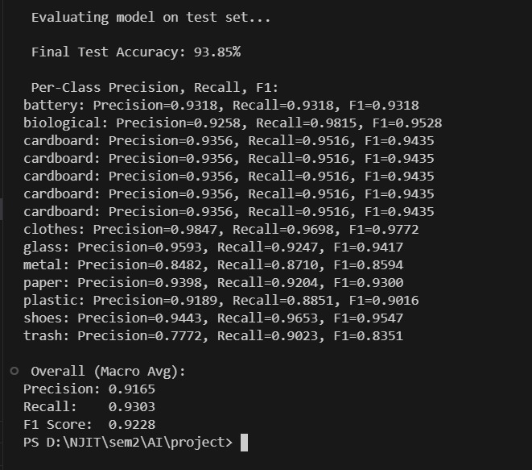
Results
Training of ResNet-50
Training of MobileNet-V3
Training of EfficientNet-B0

Slide 26
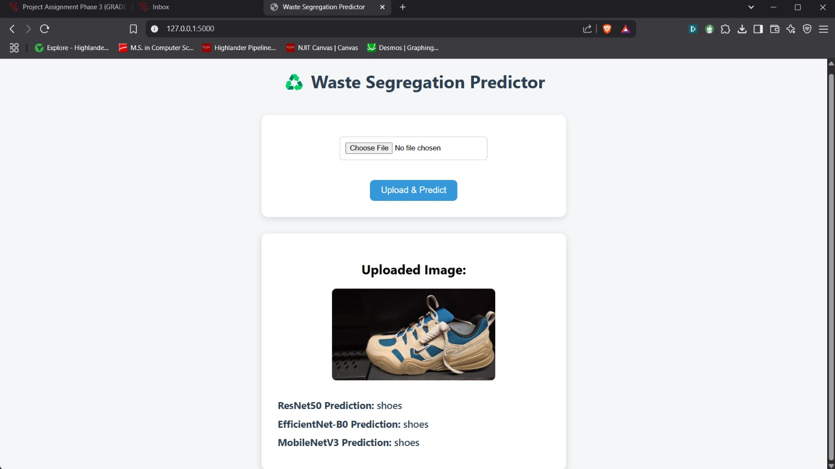
Contd.
This Waste Segregation Predictor web app allows users to upload an image and get predictions from multiple models ResNet50, EfficientNet-B0, and MobileNetV3. After uploading, the image is displayed along with each model’s classification result, providing quick and easy waste identification.

Slide 27
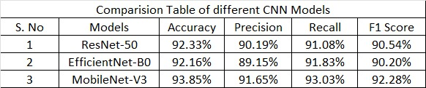
Comparison of the models

Slide 28
References
[1] S. Dookhee, ”Domestic Solid Waste Classification Using Convolutional Neural Networks,” 2022 IEEE 5th International Conference on Image Processing Applications and Systems (IPAS), Genova, Italy, 2022,15pp. 1-6, doi: 10.1109/IPAS55744.2022.10052971. keywords: Deep learning;Waste materials;Solid modeling;Climate change;Pollution;Image processing;Clothing;Automated Waste Classification;Convolutional Neural Network;Recyclable Waste;Trash Classification
[2] A. Ravishankar, A. Murthy, M. Sharma, R. K. Chitra, and R. Anitha, ”Automated Waste Segregation using Convolution Neural Network,” 2021 International Conference on Smart Generation Computing, Communication and Networking (SMART GENCON), Pune, India, 2021, pp. 1-6, doi: 10.1109/SMARTGENCON51891.2021.9645825. Keywords: Object Classification, Microcontroller, Image Processing, Residual Network, Neural Network
[3] R. Md, R. H. Sayed and A. Khan Kowshik, ”Intelligent Waste Sorting Bin for Recyclable Municipal Solid Waste,” 2021 International Conference on Automation, Control and Mechatronics for Industry 4.0(ACMI), Rajshahi, Bangladesh, 2021, pp. 1-5, doi: 10.1109/ACMI53878.2021.9528157.keywords: Waste management;Training;Waste materials; Semiconductor device measurement;Source separation;Object detection;Classification algorithms;Waste sorting;Recyclable MSW;Convolutional Neural Network

Slide 29
Conclusion
Development of the Waste Classification and Prediction system is successfully completed
All models were also tested on new, unseen waste images, and in most cases gave correct predictions. However, due to visual similarities between classes (e.g., shape or texture) and pixelation or low-quality images, the model sometimes misclassified certain items.
The system is scalable and can be deployed in real-world waste segregation setups such as smart bins or recycling facilities.
Provides a cost-effective, fast, and sustainable solution for reducing manual waste sorting and promoting environmental awareness.
Achieved high classification performance, with MobileNet-V3 outperforming others with:
Accuracy : 93.85%
Precision : 91.65
Recall : 93.03
F1 Score : 92.28%

Slide 30
Thank you!

